Slide 1

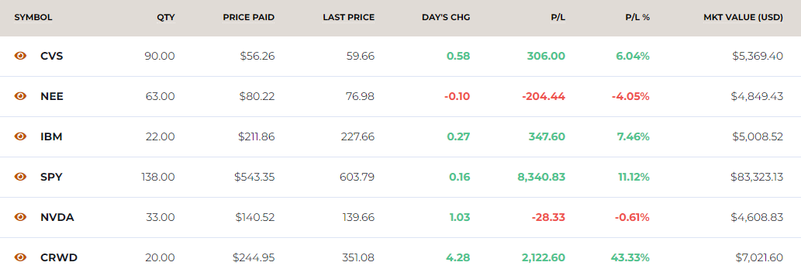
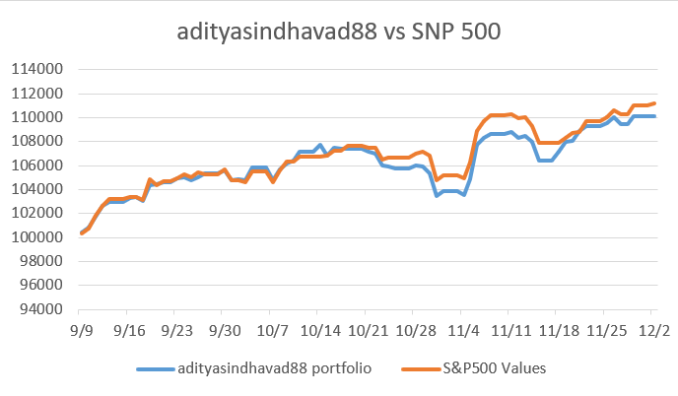
Diversification (5 selected Stocks):
CVS Health: Exposure to healthcare and retail pharmacy.
NextEra Energy: Focus on renewable energy utilities.
IBM: A tech giant, focusing on enterprise solutions.
NVIDIA: Exposure to the booming AI and chip industry.
CrowdStrike: Exposure to a growing cybersecurity market.
Stock selection reasons:
CVS: Stable returns from the healthcare sector. Leadership Changes - new CEO in October 2024, Restructuring initiatives undertaken, Deutsche Bank upgraded CVS to a "buy" rating with a $66 price target
NEE: Sustainable energy trends and as winter months were approaching
IBM: Historical strong dividends, big tech, Analyst set a $188 price target—the highest on Wall Street at that time, In Jan 2024, IBM reported a 4.1% year-over-year revenue increase and a 7.5% rise in adjusted earnings
NVDA: 217% year-over-year increase in data center revenue, 10-for-1 Stock Split making stocks accessible to investors and surpassed $3 trillion in Market Cap
CRWD: Predicted future recovery from faulty software update global issue. In July 2024 they reported 41% increase in earnings per share and a 32% rise in revenue and in June 2024 were included in S&P500
Portfolio Performance:
S&P 500 showed steady growth throughout the semester and gradually climbed to higher levels, reflecting overall positive market sentiment and performance as Federal Reserve dropped interest rates.
My portfolio replicated the S&P 500 at start, showed minor dips and recoveries but stayed ahead of the market. By 12/2, the portfolio value was above its starting value and ended with marginally trailing the S&P 500.
Portfolio Name: Adityasindhavad88
Name: Aditya Sindhavad | Eid: aks5253

Slide 2
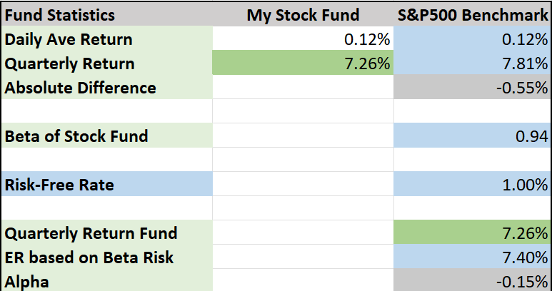
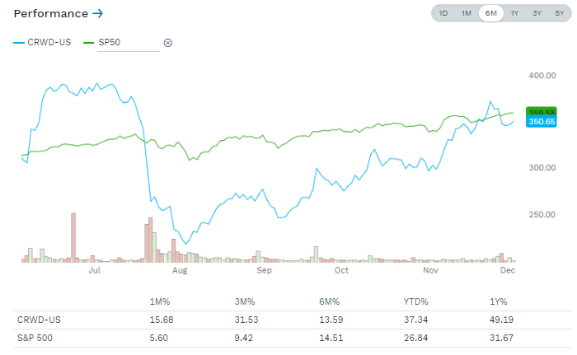
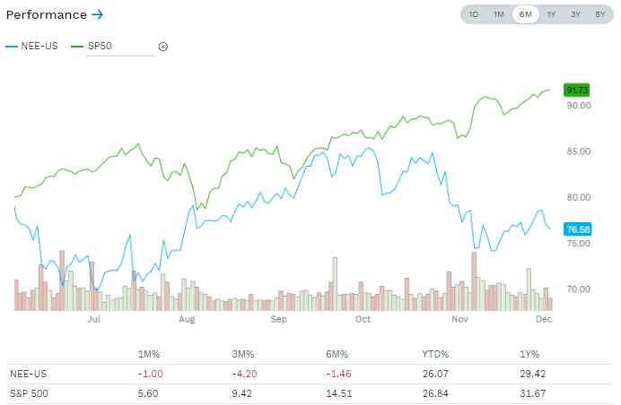
Fund Performance explanation:
adityasindhavad88 fund underperformed the S&P500 benchmark by 0.55% in quarterly returns
With a beta of 0.94, adityasindhavad88 fund is slightly less risky than the overall market, meaning it reacts less strongly to market movements
The alpha of -0.15% states that adityasindhavad88 fund slightly underperformed relative to its expected performance based on its beta,
The expected return for the fund based on its beta risk is 7.40%, but the actual quarterly return is 7.26%. This aligns closely but falls short, contributing to the negative alpha.
While adityasindhavad88 fund shows stability (lower beta), it underperformed both on an absolute basis and after risk adjustment, suggesting room for improvement in either stock selection or strategy.
Best and Worst stock from the Portfolio compared to the S&P 500
Best Performing Stock:
Crowdstrike (CRWD)
43.33%
Worst Performing Stock:
NextEra Energy Inc (NEE)
- 4.05%
Portfolio Name: Adityasindhavad88
Name: Aditya Sindhavad | Eid: aks5253

Slide 3
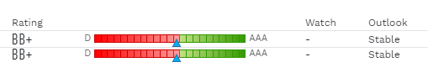
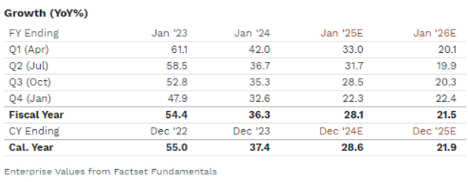
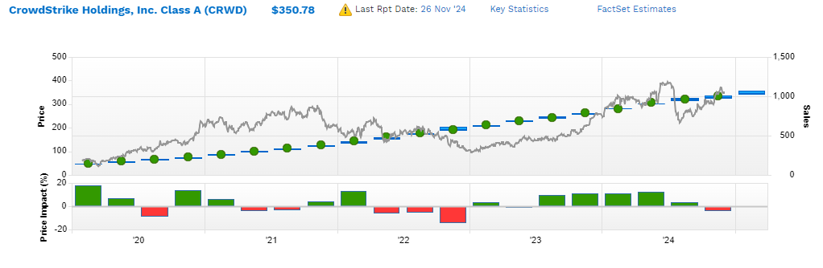
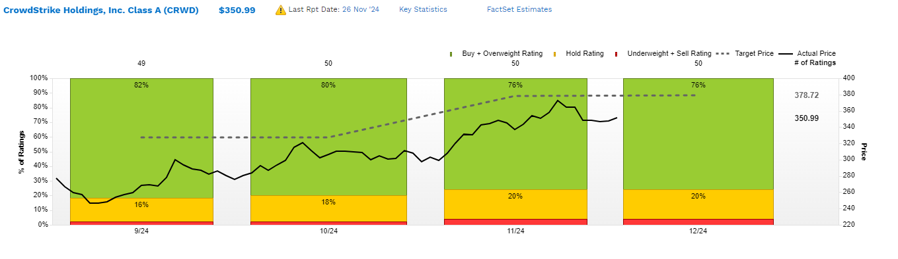
Best Performing Stock: Crowdstrike (CRWD): 43.33%
S&P ratings at BB+ for both suggest speculative grade credit. The stable outlook underscores the company’s financial reliability despite being below investment grade.
The target price trends above the current price, indicating positive analyst sentiment for future growth.
Current price ($350.99) is nearing target levels ($378.72), which might suggest limited short-term upside unless future earnings or revenue surprises occur.
The majority of analysts recommend "Buy" or "Overweight" ratings, consistently staying above 75% across the period.
The YoY growth rate shows a declining trend from 54.4% (Fiscal Year Ending Jan '23) to 21.5% (Fiscal Year Ending Jan '26), reflecting potential maturation of growth phases. Calendar year growth for 2024 is expected at 28.6%, dropping to 21.9% by 2025.
Strong correlation between sales growth and positive price impact, suggesting investor confidence in revenue expansion.
Considering the Market sentiment, the percentage of "Hold" and "Underweight" ratings remains relatively low, indicating minimal bearish sentiment among analysts. The actual price is closely tracking upward trends, supported by a robust volume of buy recommendations.
Portfolio Name: Adityasindhavad88
Name: Aditya Sindhavad | Eid: aks5253

Slide 4
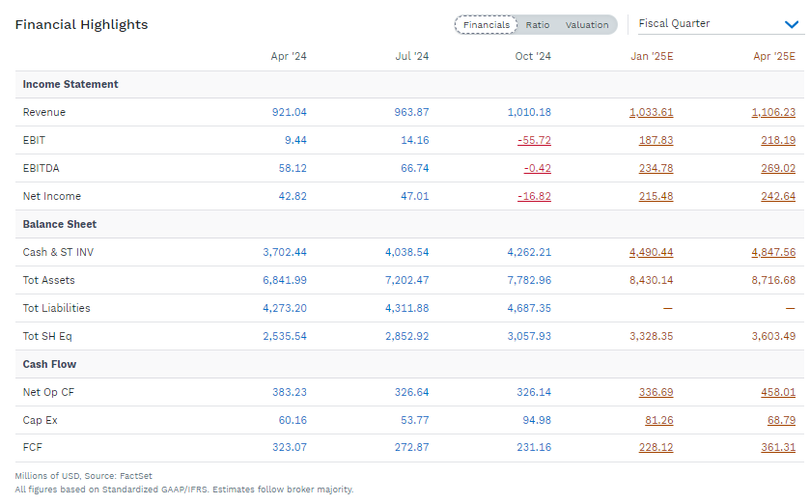
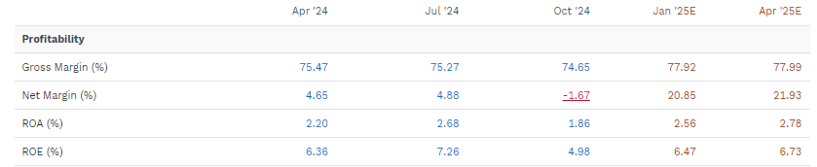
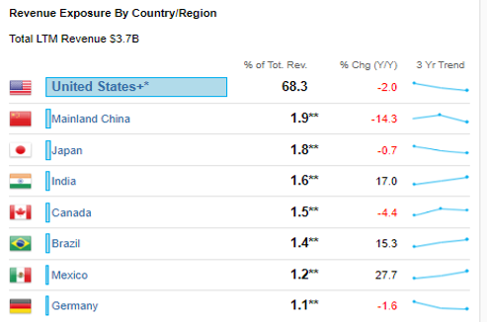
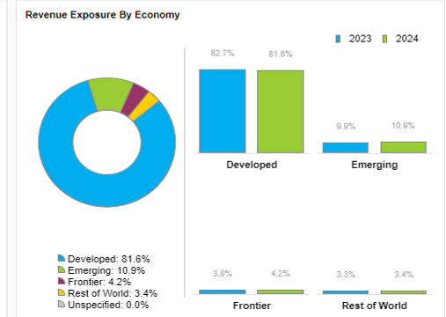
Revenue is expected to consistently increases from $921M in Apr '24 to $1,106M in Apr '25
EBIT experienced a significant dip in Oct '24 (-$55.72M) and is expected to recover to $218.19M in Apr '25, indicating temporary operational inefficiencies.
Net Income turns negative in Oct '24 (-$16.82M) but is expected to rebounds strongly by Jan '25 ($215.48M)
Gross margin remains stable around 75% to 77%, showcasing cost efficiency in operations
Net margins is expected to improve highly from -1.67% in Oct '24 to 21.93% in Apr '25, reflecting the impact of higher revenue and cost management.
Both ROA and ROE show consistent improvement in FY '25, signaling better asset and equity utilization
India (+17%) and Mexico (+27.7%) show the strongest YoY growth, presenting opportunities for expansion in emerging markets
Mainland China (-14.3%) and Canada (-4.4%) experience notable revenue declines, possibly due to geopolitical or economic challenges
Portfolio Name: Adityasindhavad88
Name: Aditya Sindhavad | Eid: aks5253

Slide 5
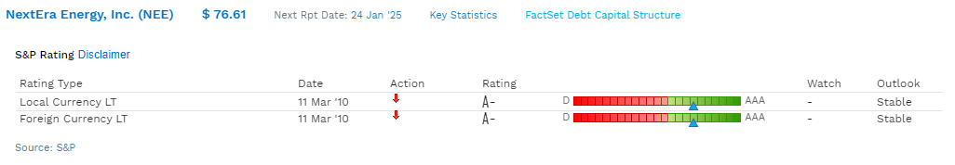
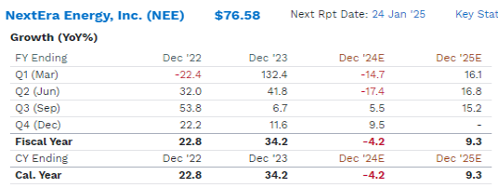
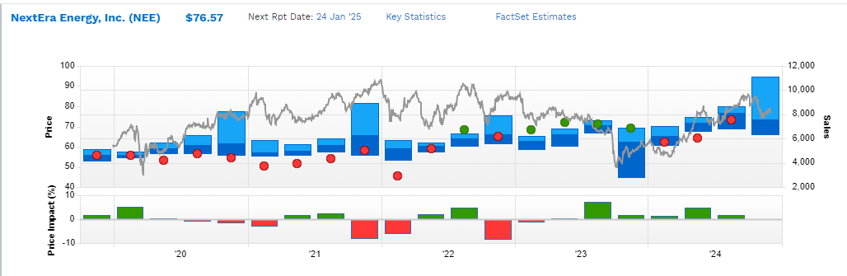
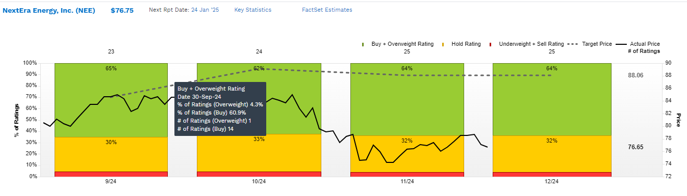
Worst Performing Stock: NextEra Energy Inc (NEE): - 4.05%
The "A-" local and foreign currency ratings with a stable outlook reflect strong creditworthiness and financial stability, with potential for improvement.
Significant volatility in quarterly growth rates is observed, with a steep decline in Q1 '24 (-14.7%) and is expected to be followed by a recovery in Q1 '25 (16.1%).
Fiscal Year growth rate declines from 34.2% in Dec '23 to -4.2% in Dec '24, showing a shift in growth dynamics before recovering to 9.3% in Dec '25
The company will take 1 complete year to recover and grow back to normal functioning
The price has generally been stable, indicating confidence among investors despite fluctuations in growth.
64% of analysts rate the stock as "Buy" or "Overweight," reflecting positive sentiment, while 32% remain in the "Hold" category. No significant bearish outlook, as "Underweight" or "Sell" ratings are minimal or absent.
The target price ($88.06) is notably higher than the current price ($76.75), suggesting potential upside if growth and performance improve as projected. Analysts' optimistic ratings align with the projected recovery in growth rates for FY '25.
Portfolio Name: Adityasindhavad88
Name: Aditya Sindhavad | Eid: aks5253

Slide 6
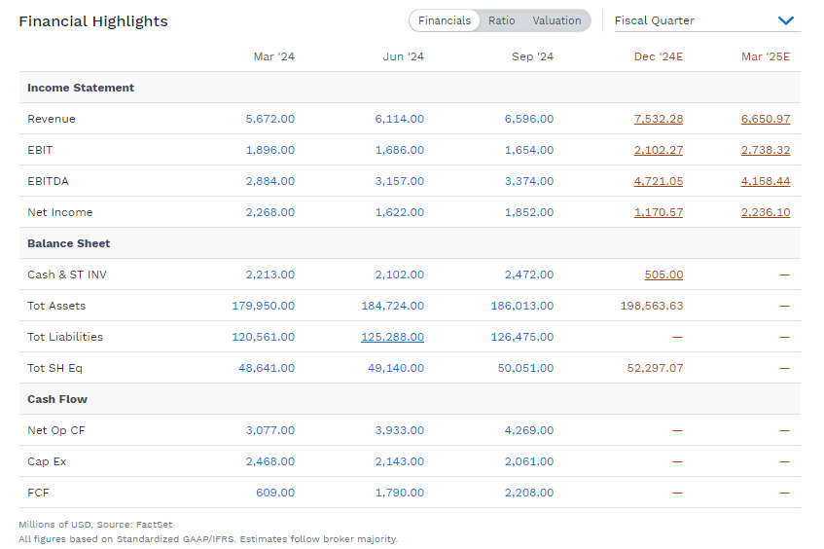
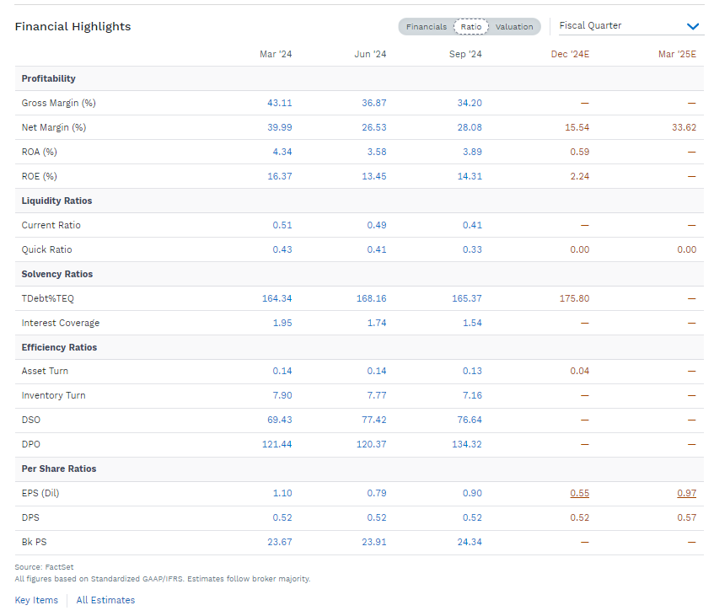
Revenue shows consistent growth from $5.67B in Mar '24 to an estimated $6.65B in Mar '25, reflecting strong operational performance
EBIT and EBITDA see fluctuations but are projected to recover by Mar '25, with EBIT expectedly reaching $2.74B in Mar '25
Net Income declines in Dec '24 to $1.17B but is expected to rebound strongly to $2.24B in Mar '25, showing robust recovery potential for future
The Cash and short-term investments have decreased significantly to $505M by Dec '24, raising concerns about liquidity management and hence the stock value had plummeted
Asset Turn and Inventory Turn show marginal declines, indicating reduced efficiency in asset and inventory management
DSO and DPO remain stable but indicate room for improvement in accounts receivable and payable management
Both ROA and ROE decline significantly by Dec '24 but are expected to recover with net income growth in early '25
EPS drops to $0.55 in Dec '24 but rebounds to $0.97 by Mar '25, reflecting the projected income recovery
Portfolio Name: Adityasindhavad88
Name: Aditya Sindhavad | Eid: aks5253

Slide 7
Key Takeaways and Lessons Learnt:
The importance of diversifying investments across different sectors (healthcare, tech, AI, cybersecurity, and energy). It reduces risk and helps in balancing losses from underperforming sectors like energy (NEE) with gains from sectors like cybersecurity (CRWD)
Some stocks went very high like Tesla, from that I learnt that overall market sentiment affects stock performance, especially when economic factors are at play -Federal Reserve's interest rate changes
Analysing stock fundamentals like revenue growth and analyst ratings helped in making well-informed choices, as we saw Spirit Airlines declare bankruptcy, the analysts were hinting from a very long time and their revenues were not good.
Through this simulation and mini stock trading experience, I am confident that I can successfully invest in the real world and make well-informed decisions based on thorough analysis before committing to any investments.
Portfolio Name: Adityasindhavad88
Name: Aditya Sindhavad | Eid: aks5253

